Slide 1
Week 13-15
Data Science Capstone Project
ISB02303402 – Data Science
Semester 2025.2 - 3 Credits
Prof. Dr. Trianggoro Wiradinata, M.Eng.Sc., CDSS.
Christopher Andreas, S.Stat., M.Stat., CDSS.

Slide 2

Learning Objectives
LO13.1 Revisiting and CRISP-DM
LO13.2 Advanced Data Science Analysis
LO13.3 Project Report

Slide 3
What is Capstone Project
A capstone project is a culminating assignment, on which students usually work on during their final weeks at the end of the academic semester. It requires different intellectual activities. This project helps student learn how to find and analyse information and how to work with it efficiently.
It has a wide variety of forms. This means that a capstone program can be submitted in various forms including a multimedia presentation, film, performance, or paper. A capstone research project is very similar to a college thesis, only smaller scope.
No one can argue that this type of work is a bit more complicated as writing a capstone project involves a wider range of activities like critical thinking, deep analysis, and the ability to use different media.

Slide 4
Who – Where – When
You will work in a team of max 3 students
Dataset can be selected from the following providers:
UCI Repository: https://archive.ics.uci.edu/datasets
Data World: https://data.world
Satu Data: https://katalog.satudata.go.id/dataset
Kaggle: https://www.kaggle.com
The latest submission date is the final exam date
Week 13 – Industry Guest Lecture. Dataset registration (unique).
Week 14 – EDA and Preliminary Analysis (10% of ALP)
Week 15 – Final Presentation (40% of ALP)
Week 16 – Paper Submission (50% of ALP)

Slide 5
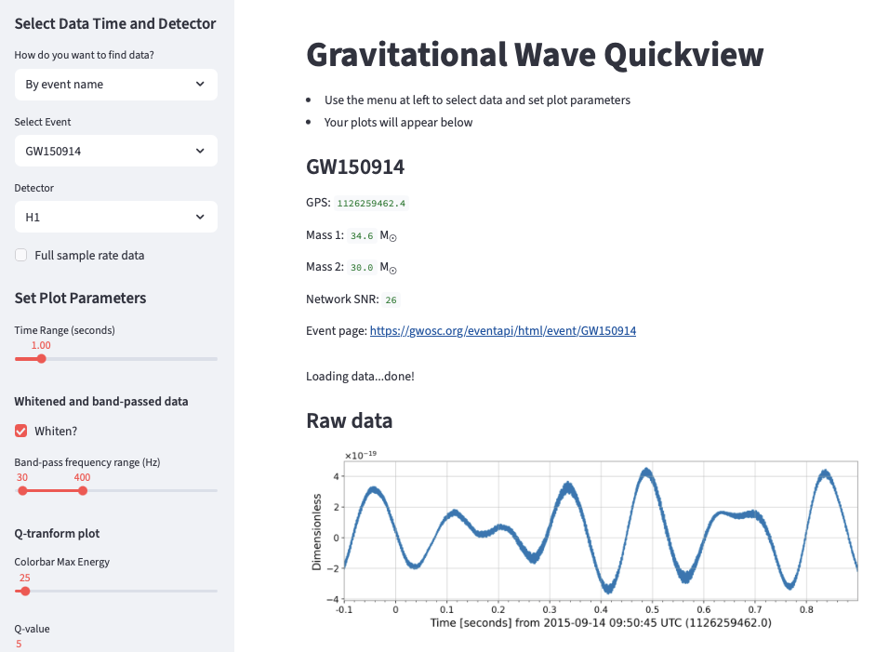
Notes on Week 15 - Final Presentation
Use Streamlit to create a visually appealing user interface for your ML application.
Parameters should be adjustable through the left sidebar.
Include visualizations to help users better understand the training data.
Deploy your application on Streamlit Community Cloud.

Slide 6
Notes on Week 16 – Paper Submission
Paper writing standard should be following JUISI: https://journal.uc.ac.id/index.php/JUISI
Number of pages between 8-10
The use of Generative AI is encouraged, however similarity must be ≦ 25%
Python code not necessarily need to appear in the paper
Large graphics (e.g.: Pair Plot, Correlation Analysis, etc.) should be attached as appendixes
Examples for the content: https://journal.yrpipku.com/index.php/jaets/article/view/918

Slide 7
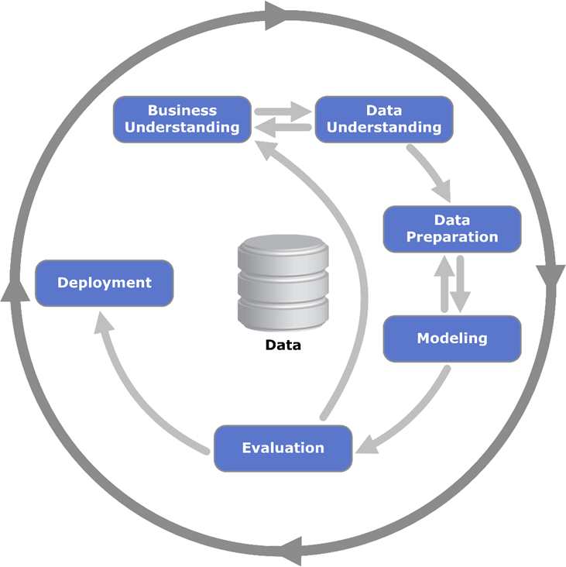
Our Methodology
The CRISP-DM (Cross-Industry Standard Process for Data Mining) methodology is a widely used framework for guiding data science and machine learning projects. It consists of six sequential phases, each serving a specific purpose:
Business Understanding
Data Understanding
Data Preparation
Modeling
Evaluation
Deployment

Slide 8
Phases of CRISP-DM
Business Understanding:
Understand the business problem or objective.
Define project goals, success criteria, and constraints.
Identify stakeholders and their requirements.
Data Understanding:
Collect and explore the data.
Understand data sources, quality, and structure.
Perform exploratory data analysis (EDA) to gain insights.
Data Preparation:
Clean and preprocess the data.
Handle missing values, outliers, and inconsistencies.
Transform and engineer features for modelling.

Slide 9
Phases of CRISP-DM (Cont’d)
Modelling:
In this phase, you build and train machine learning models.
Select appropriate algorithms (e.g., regression, classification, clustering).
Fine-tune hyperparameters using techniques like cross-validation.
Evaluate model performance using metrics (e.g., accuracy, precision, recall, F1-score).
Evaluation:
Assess the model’s performance on unseen data (validation or test set).
Compare different models and select the best one.
Consider business goals and constraints (e.g., false positives vs. false negatives).
Deployment:
Deploy the chosen model into a production environment.
Integrate the model with existing systems or applications.
Monitor model performance and retrain as needed.

Slide 10
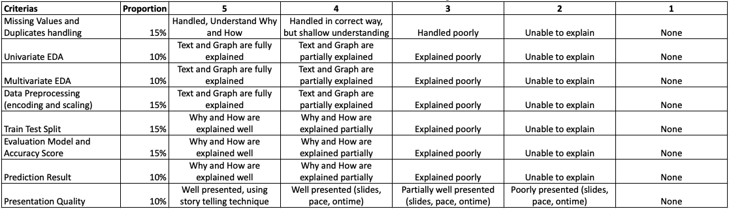
Grading V.1.0
Note the final grade will be multiplied by the teamwork score (ranges from 0.8 to 1.0)
Teamwork score of 0.8 denotes poor teamwork, 1.0 indicates excellent teamwork.

Slide 11

Thank You and Have a Great Day

